Slide 1
Predicting One-Year Survival
After Hospital Discharge
A comparison of Cox regression, random survival forests, DeepSurv and Cox-Time
Oded Katz · Diana Morgan

Slide 2
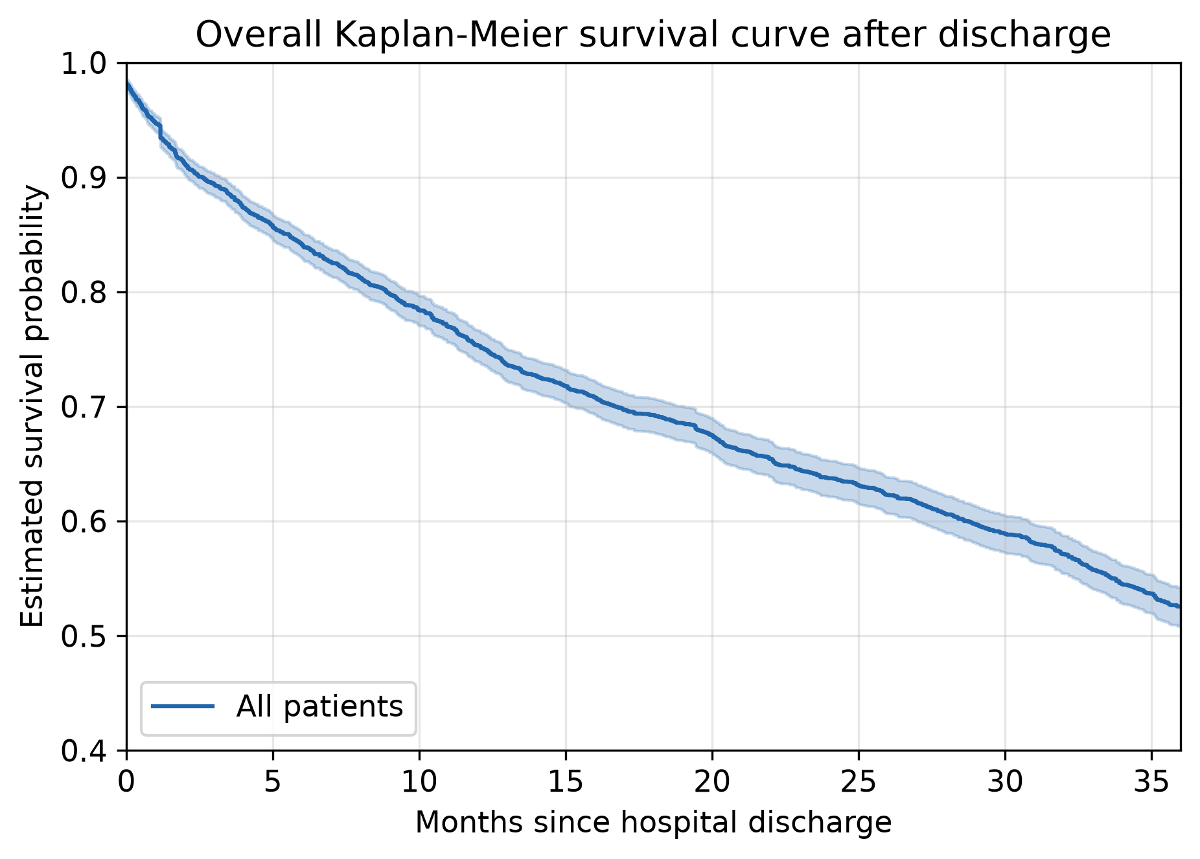
The cohort
3,961
1,679
25.6
patients discharged alive
deaths (42.4%)
months median follow-up
Acute decompensated heart failure, discharged alive; 25 covariates known at discharge
Event: death from any cause, time in months from discharge
Administrative censoring at 36 months — 1,473 of the 2,282 censored patients end there
Overall survival: 0.53 at 36 months, about 0.75 at one year
Median age 76 · 46.5% women
1
Notes:
Almost 4000 patients admitted to hospital with a heart failure and discharged alive. The data then follows up on them for up to 36 months recording death and censoring events (time in months),
after which all the remaining patient outcomes are censored.
There are 25 covariates available, composed of demographics, laboratory measurements, and prior conditions (e.g. hypertension)
About 1600 are dead at the end of the follow up, while accounting for censoring - a bit more then half survive to the end, with 75% alive at the end of one year.
Majority of censoring events are administrative – at the end of the follow up.
KM descends to 0.53 at the end of period, with steepest at the first few months, then close to linear.

Slide 3
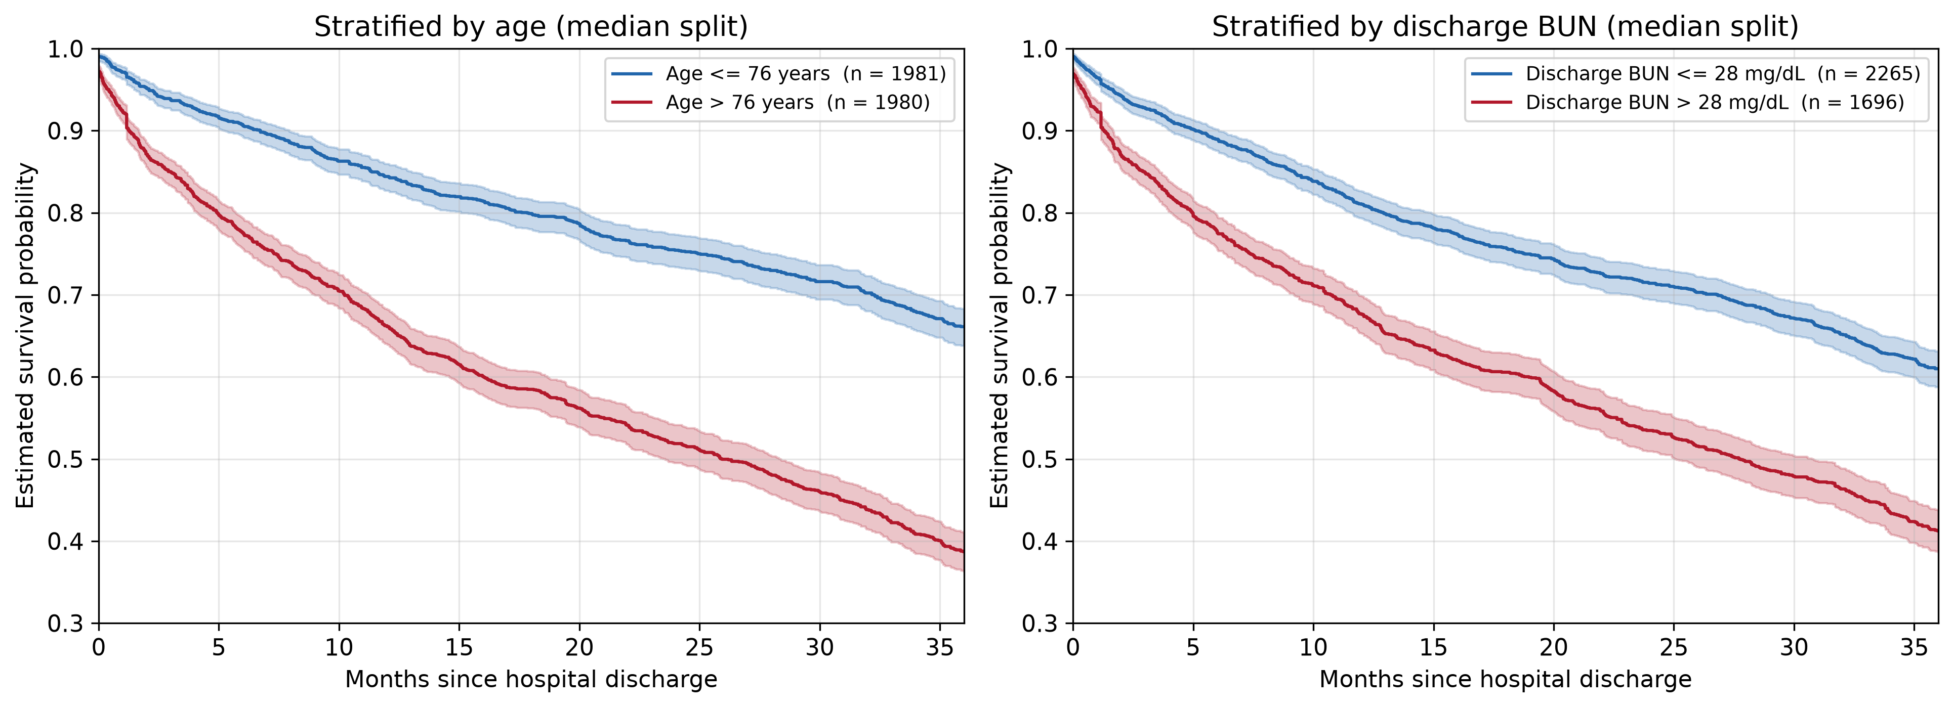
PA1: Exploration
One-year survival differs by 0.18 across age and by 0.13 across discharge BUN
Split at the medians of age (76 years) and discharge BUN (28 mg/dL).
Sex and diabetes, the stratifications our PA1 started from, separate nothing.
2
Notes:
To recap the first project assignment which mostly dealt with the exploration of the data:
We have attempted different stratifications back in PA1 – sex and diabetes – which showed to separate nothing.
Our new, more insightful stratification is, as you can see, on age and discharge BUN levels split at the median. As we can see on the graphs, older patients, as well as patients with higher BUN levels have worth outcomes.
Reminder that over all KM falls to about 0.53 at 36 months.
We see clear connection between (some) covariates and the outcome – it motivates later attempts at prediction rather well.

Slide 4
PA2: Cox model
Covariate | HR | p
Age (per year) | 1.044 | < 0.001
BUN, discharge | 1.021 | < 0.001
Sodium | 0.973 | < 0.001
BNP | 1.0002 | < 0.001
ΔBUN | 0.990 | < 0.001
RDW | 1.120 | < 0.001
Length of stay | 1.009 | 0.001
Bilirubin | 1.121 | 0.037
Potassium | 0.914 | 0.038
ΔBUN adds information
Likelihood ratio 27.63 on 1 df, p = 1.5 × 10⁻⁷
Proportional hazards possible mild violations
Schoenfeld flags discharge BUN (0.036) and length of stay (0.048)
Log-normal AFT agrees
Same directions throughout; the two diverge only in the BUN tail
+ 7 terms not associated with survival in any fit
In-sample concordance 0.694
3
Notes:
Part 2 of the assignments moves on to modeling. The Cox model we settle on includes nine significant terms, including delta BUN – a term we constructed from the difference between discharge and intake BUN levels.
It has proven to be a useful predictor via a likelihood ratio test against a model with all the variables but it. Fit on all of the data.
We see the same terms that successfully stratified in part 1 are now hold high significance as predictors.
Cox assumes three things that will be relevant later:
Linearity (--- 60 -> 70 age is same as 70 -> 80 ---),
Additivity (--- No covariate modifies another’s effects (no interaction terms) ---)
Proportional Hazards (--- baseline hazard is independent of time, depends only on the covariates X ---)
Of these we test the proportional hazards assumption with the Schoenfeld residual test, detecting two (mildly) significant variables – BUN discharge and length of stay, nothing drastic visible on the residual plots.
----------------
Reminders:
Cox models the hazard – not survival directly : h(t | X) = h0​(t) exp(β1 ​x1​+⋯+βp​ xp​) S_hat 0 ​(t)=e^(−H_hat 0​ (t) )
Baseline hazard is not estimated, use partial likelihood to fit : (given exactly one death happened now – what’s the probability it was *this* patient out of the risk set). Baselines cancel out.
HR > 1 is worse
Example: Age HR = 1.044 -> 4.4% higher hazard for one more year. 10 more years -> 1.044^10 = 1.55 = 55% higher hazard.
(hazards are multiplicative)
Concordance = shown two patients, does the model correctly say which one dies sooner?

Slide 5
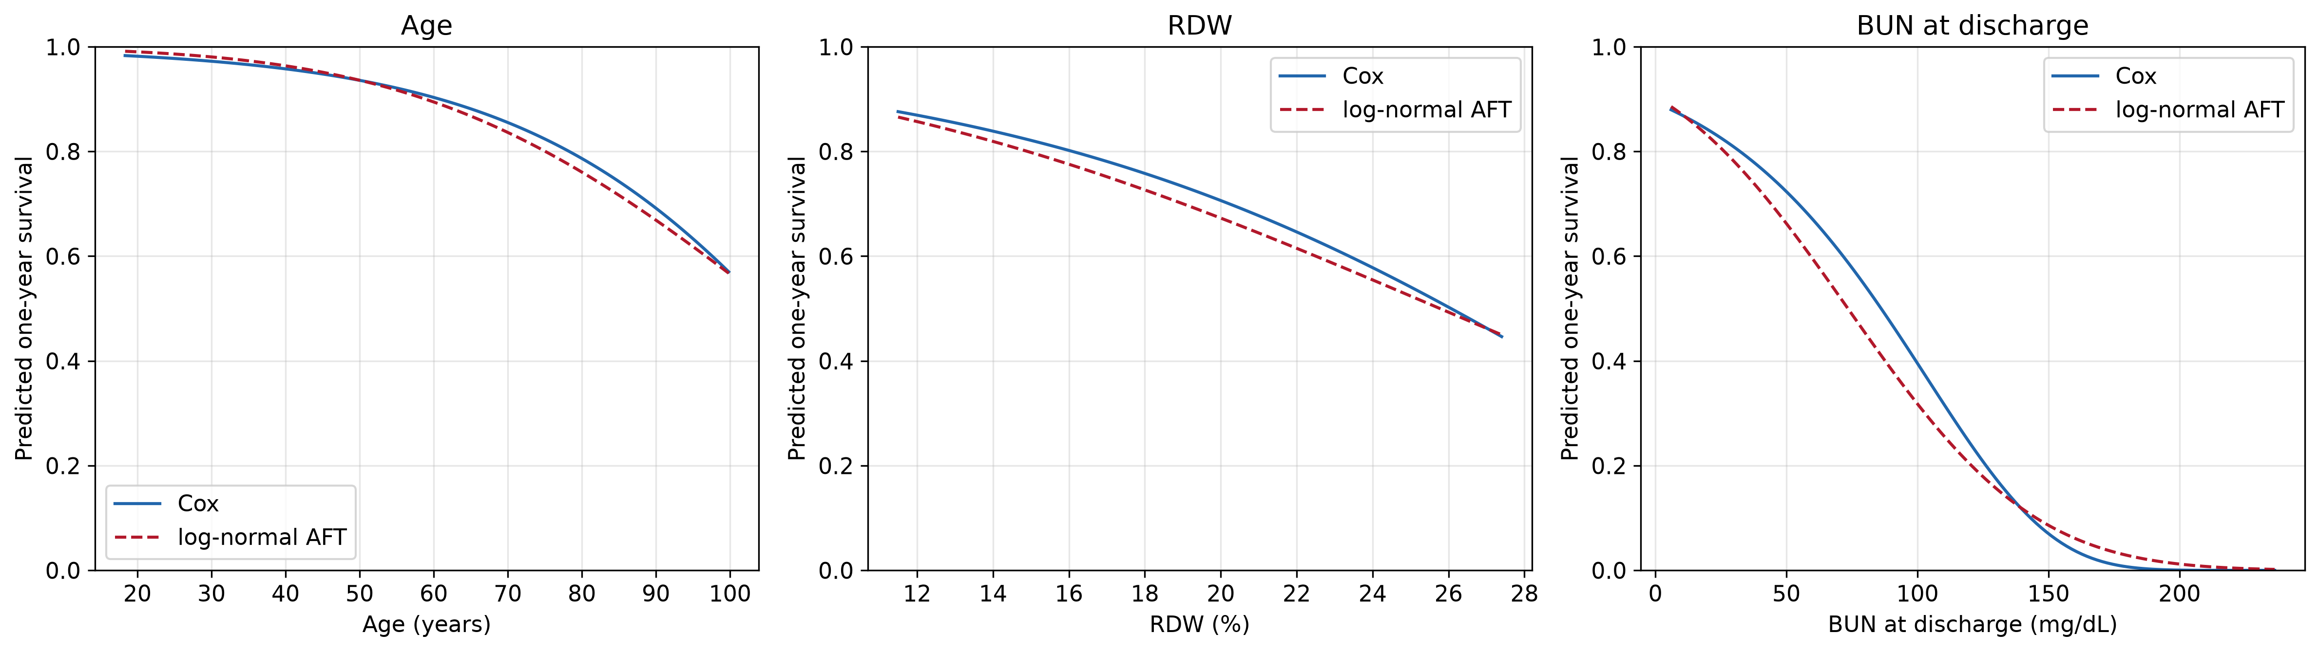
PA2: Cox against the log-normal AFT model
Backup
Full observed range. The two agree for age, separate slightly for RDW, and diverge for discharge BUN — where three quarters of patients sit below 39 mg/dL.
Notes:
Where they disagree is high BUN. And there's almost nobody there — three quarters of patients have BUN under 39, but the axis runs to 236. So the whole visible disagreement happens in a corner of the plot holding a handful of people. Out there neither model has data, so each is just guessing in its own way.
------------------
Reminders:
AFT (accelerated failure time) models survival time : logT = μ+βX + σW S(t ∣ X) = S0 ​(t / exp(βX)) ; S0 – survival curve of reference patient (X = 0), S0​(u)=1−Φ((logu−μ0​​) / σ).
In log-normal AFT W is normal distribution
In an AFT model there is only ever one survival curve. Every patient rides that same curve. Covariates change nothing about its shape — they only change how fast you travel along it.
ϕ=exp(βX) is that speed. ϕ=0.8 means this patient moves through the curve 1/0.8 = 1.25× faster than the reference. ϕ=1.2 would mean slower, i.e. better off

Slide 6
Research questions – Old Versions
1
Does the difference between BUN on admission and on discharge have a significant effect on the survival outcome?
Answered in PA2
2
Are there covariate interactions with a significant effect on the survival outcome?
105 interactions – too much to check
3
How accurately can survival be predicted at hospital discharge?
Not yet addressed
4
Notes:
We modify the questions we had in PA1
(
> RQ1 (PA1). Does the difference between BUN on admission and on discharge have a significant effect on the survival outcome?
> RQ2 (PA1). Are there covariate interactions with a significant effect on the survival outcome?
> RQ3 (PA1). How accurately can survival be predicted at hospital discharge?
)
First one was answered in PA2.
Second one – testing 105 interactions is likely to give us something significant by chance, we concentrate on two specific interactions instead.
Third – still of interest, not yet addressed

Slide 7
Research questions – Improved and Adjusted
1
How accurately can one-year survival be predicted at discharge — and do the more flexible models beat Cox?
the four models are compared once, on the held-out test set
2
Where the flexible models differ from Cox, which of the Cox model's assumptions is responsible?
linearity · additivity · proportional hazards
3
Do two pre-specified interactions improve on the additive Cox model?
ΔBUN × discharge BUN · age × discharge BUN
4
Notes:
RQ1: PA1's third question improved.
RQ2: We relax different assumptions as we move on to different models and observe what has a true effect on the modeling. This is especially motivated by mild but present PH violation we found earlier
RQ3: We select two specific interactions that make sense:
Delta-BUN with discharge BUN are likely to affect one another, as the change is likely to have different strange of effect on different numeric levels of BUN
Age with discharge BUN are the two strongest predictors – their potential interaction is the most interesting one to explore.

Slide 8
Train–test split
Training · 3,168 patients
Test · 793
80%
20%
Stratified by the event indicator — 42.4% events in both sets
748 deaths within 12 months in training · 199 in test
5
Notes:
80/20, stratified by the event indicator so the event rate — 42.4% — is identical in both sets. Training 3,168 patients, 1,343 events, 748 deaths within 12 months. Test 793 patients, 336 events, 199 deaths within 12 months.

Slide 9
The Cox model refitted on training data
No hazard ratio moves by more than 2.2%
Covariate | HR train | HR full | p train | p full
Age (per year) | 1.0447 | 1.0438 | < 0.001 | < 0.001
BUN, discharge | 1.0238 | 1.0213 | < 0.001 | < 0.001
RDW | 1.1295 | 1.1204 | < 0.001 | < 0.001
ΔBUN | 0.9900 | 0.9903 | < 0.001 | < 0.001
BNP | 1.0002 | 1.0002 | < 0.001 | < 0.001
Sodium | 0.9726 | 0.9728 | < 0.001 | < 0.001
Length of stay | 1.0083 | 1.0094 | 0.010 | 0.001
Bilirubin | 1.0988 | 1.1208 | 0.126 | 0.037
Potassium | 0.9196 | 0.9141 | 0.078 | 0.038
Every full-data estimate falls inside the training confidence interval. Concordance 0.699 against 0.694.
Bilirubin and potassium lose significance — the intervals widen, the effects do not move.
6
Notes:
Same model, training patients only, with the full-data estimates alongside.
I wouldn’t waste our time going into it too deeply, the main point is – nothing has moved too significantly from the full data model, estimates are stable.
The exception is Potassium and Bilirubin losing significance – likely from widening of the confidence intervals.
Seven terms remain significant with essentially unchanged hazard ratios
(maybe: "The hazard ratio below 1 isn't saying a rise in BUN is good — with discharge BUN already in the model, it's saying that starting higher is bad.“)

Slide 10
Proportional hazards on the training data
No covariate is flagged in both fits
Covariate | p (train) | p (full)
Comorbidity burden 4+ | 0.021 | 0.100
Comorbidity burden 2–3 | 0.025 | 0.239
Bilirubin | 0.035 | 0.117
BUN, discharge | 0.116 | 0.036
Length of stay | 0.137 | 0.048
Training is four fifths of the same cohort — a genuinely time-varying effect would persist in it
Smallest p anywhere in either fit: 0.021, across sixteen simultaneous tests
Schoenfeld residual test on a rank transform of time; flagged at p < 0.05
7
Notes:
Same Schoenfeld test,
The training set is not independent data — it is four fifths of the same cohort. A hazard ratio that genuinely varied over follow-up would still vary in that subset. Flags that swap like this look like noise, especially so close to p-value threshhold
We conclude that PH assumption likely holds.

Slide 11
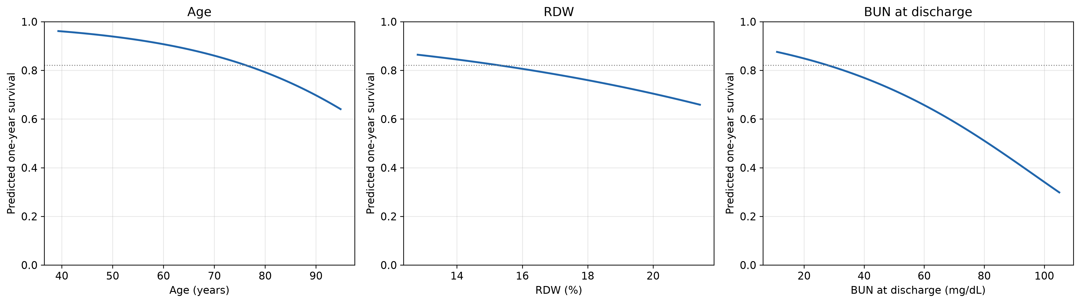
One-year survival prediction
Grids run from the 1st to the 99th training percentile. Dotted line: the representative patient.
Representative patient — a man of 76 with median labs — has predicted one-year survival 0.821
Across the plotted grid
Over the interquartile range the order reverses
BUN 0.876 → 0.298 · age 0.962 → 0.641 · RDW 0.864 → 0.659
age 0.11 · BUN 0.06 · RDW 0.03
8
Notes:
In practical terms, the baseline one-year survival is 82%. Because the covariates are centred, that corresponds to a patient with average characteristics in the training data, not to a patient for whom every covariate is zero.
The representative patient is medians for continuous covariates and the most common level for comorbidity burden.
The grids run from the 1st to the 99th percentile rather than min to max (remove extreme outliers): discharge BUN reaches 199.7 in the training set but its upper quartile is 38, so a full-range axis would spend most of its length where almost no patients are.
interquartile range = Q3 – Q1 – middle 50%
So, age matters most for a typical patient, while discharge BUN dominates the plotted range because of its long right tail and matters most for the minority discharged with high values.
All three curves have the same basic shape: they decline and then level off. But that shape comes from the way the Cox model is specified; it is not something we learned from the data. The flexible models let us check whether the data actually support that pattern.
----------
Reminders
Breslow baseline :
go through the data and count deaths as they happen, but instead of counting each person at risk as one person, count them by how sick the model says they are. A high-risk patient counts as more than one. That gives you a curve for someone of average sickness.
Then you get any individual patient's prediction by pushing that curve down (for riskier patients) or up (for safer ones).

Slide 12
Covariate summary
Backup
All 3,961 patients. Continuous: median [Q1, Q3]. Binary: n (%).
Demographics & comorbidities | Summary
Age (years) | 76.2 [66.9, 83.2]
Female sex | 1,842 (46.5%)
Diabetes | 2,147 (54.2%)
Hypertension | 3,432 (86.6%)
COPD | 405 (10.2%)
Peripheral vascular disease | 367 (9.3%)
Chronic kidney disease | 805 (20.3%)
Ischaemic heart disease | 2,484 (62.7%)
Atrial fibrillation | 1,608 (40.6%)
Valvular heart disease | 981 (24.8%)
Pulmonary hypertension | 737 (18.6%)
Laboratory values & stay | Summary
BNP, admission (pg/mL) | 778 [734, 832]
BUN, admission (mg/dL) | 25.0 [19.0, 37.0]
Creatinine, admission (mg/dL) | 1.23 [0.95, 1.70]
GFR, admission | 49.8 [34.6, 67.6]
BUN, discharge (mg/dL) | 28.0 [22.0, 39.0]
Creatinine, discharge (mg/dL) | 1.23 [1.00, 1.56]
GFR, discharge | 50.4 [34.8, 67.6]
White blood cells (1000/µL) | 8.92 [7.00, 11.42]
Sodium (mEq/L) | 138 [135, 140]
RDW (%) | 15.3 [14.5, 16.1]
Platelets (1000/µL) | 225 [180, 280]
Bilirubin (mg/dL) | 0.60 [0.50, 0.72]
Potassium (mEq/L) | 4.30 [3.90, 4.60]
Length of stay (days) | 5.13 [3.08, 8.34]
Notes:
Backup: full covariate table

Slide 13
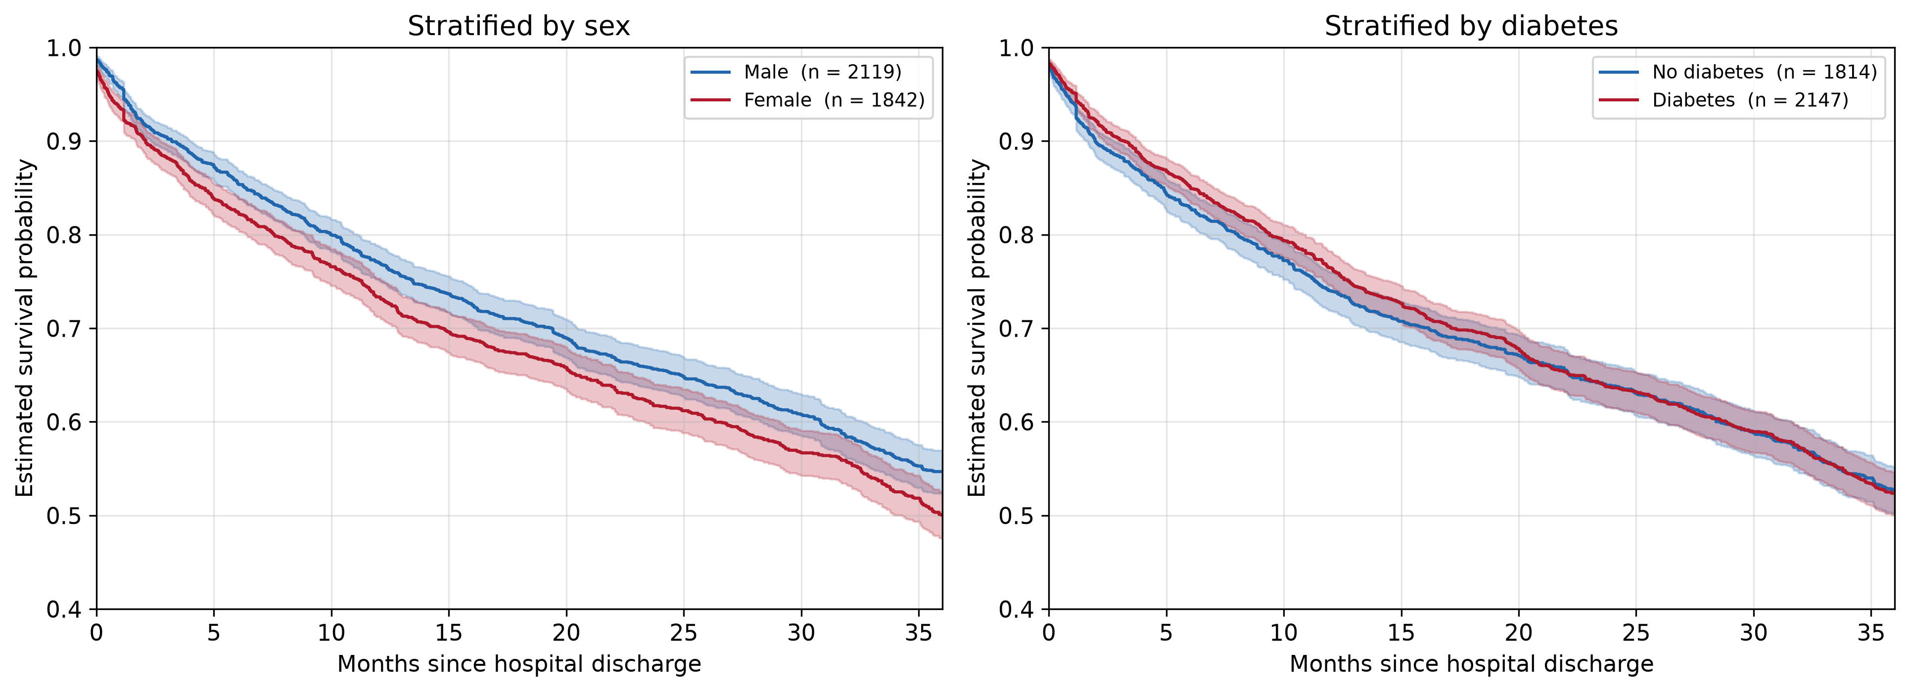
PA1: sex and diabetes
Backup
One-year survival 0.770 against 0.733 by sex, and 0.740 against 0.764 by diabetes. Neither separates the cohort.
Notes:
Backup: the two stratifications PA1 started from

Slide 14
Refitted Cox model — all sixteen terms
Backup
Covariate | HR (train) | 95% CI (train) | p (train) | HR (full) | p (full)
Age (years) | 1.0447 | 1.0384 – 1.0511 | < 0.001 | 1.0438 | < 0.001
BUN, discharge | 1.0238 | 1.0197 – 1.0279 | < 0.001 | 1.0213 | < 0.001
RDW | 1.1295 | 1.0963 – 1.1638 | < 0.001 | 1.1204 | < 0.001
ΔBUN | 0.9900 | 0.9861 – 0.9940 | < 0.001 | 0.9903 | < 0.001
BNP | 1.0002 | 1.0001 – 1.0002 | < 0.001 | 1.0002 | < 0.001
Sodium | 0.9726 | 0.9611 – 0.9843 | < 0.001 | 0.9728 | < 0.001
Length of stay | 1.0083 | 1.0020 – 1.0146 | 0.010 | 1.0094 | 0.001
Bilirubin | 1.0988 | 0.9738 – 1.2400 | 0.126 | 1.1208 | 0.037
Potassium | 0.9196 | 0.8376 – 1.0096 | 0.078 | 0.9141 | 0.038
Platelets | 1.0005 | 0.9998 – 1.0012 | 0.147 | 1.0004 | 0.100
Creatinine, discharge | 0.9172 | 0.8345 – 1.0080 | 0.073 | 0.9376 | 0.132
Comorbidity burden 2–3 | 0.8754 | 0.7181 – 1.0672 | 0.188 | 0.8885 | 0.195
White blood cells | 1.0001 | 0.9918 – 1.0085 | 0.976 | 1.0028 | 0.436
Female sex | 0.9809 | 0.8720 – 1.1035 | 0.749 | 0.9693 | 0.558
GFR, discharge | 1.0014 | 0.9975 – 1.0053 | 0.492 | 1.0010 | 0.585
Comorbidity burden 4+ | 0.9835 | 0.8046 – 1.2021 | 0.871 | 0.9882 | 0.898
Notes:
Backup: the full sixteen-term refitted model with confidence intervals. Use for any coefficient question.

Slide 15
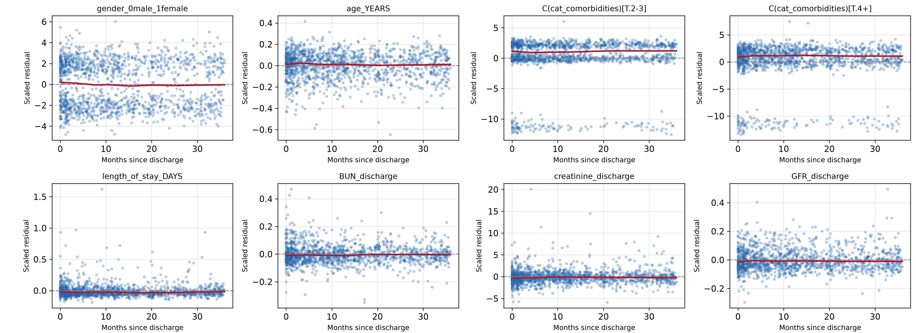
Scaled Schoenfeld residuals — training fit (1 of 2)
Backup
Lowess smoother in red. The comorbidity panels band because the variable enters as dummy indicators — coding, not a violation.
Notes:
Backup: Schoenfeld residual panels from the training fit, first eight terms. Smoothers are flat almost everywhere, with none of the steady drift a genuinely time-varying hazard ratio would produce. The terms flagged by the formal test look no different by eye from the rest.

Slide 16
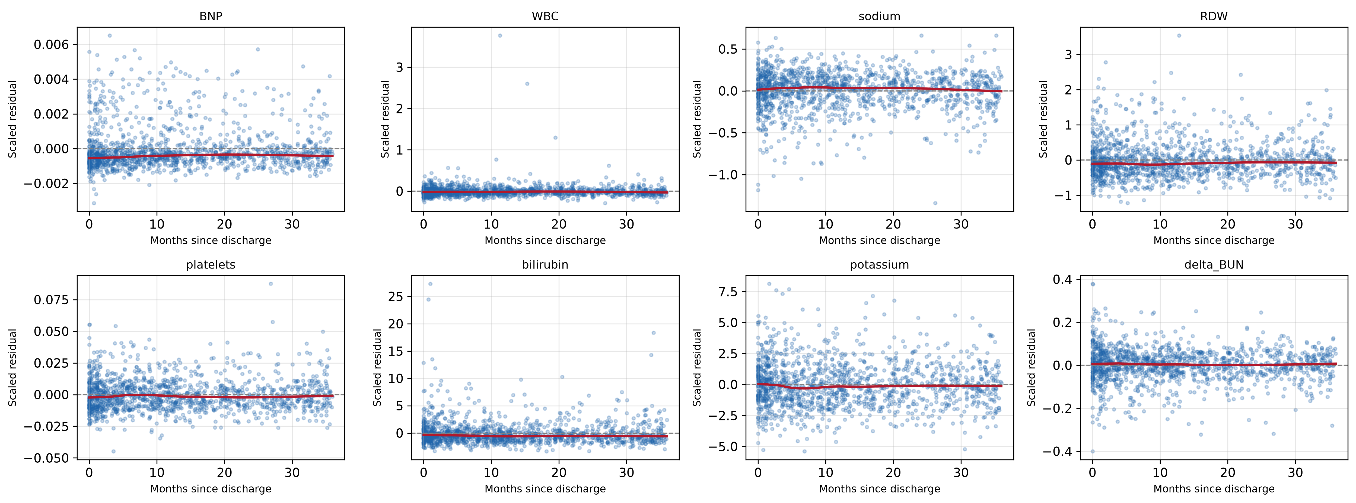
Scaled Schoenfeld residuals — training fit (2 of 2)
Backup
Panel titles are the raw model terms; delta_BUN is ΔBUN and C(cat_comorbidities) the comorbidity burden dummies.
Notes:
Backup: Schoenfeld residual panels from the training fit, remaining eight terms. Same reading — flat smoothers throughout.

